Slide 1

Explainable Predictive Modeling of Chronic Kidney Disease Via LLMs
Reseach Project Funded by HED
Team Members :
Muhammad Huzaifa
Zubair Ahmed
Syed Muhammad Saad

Slide 2
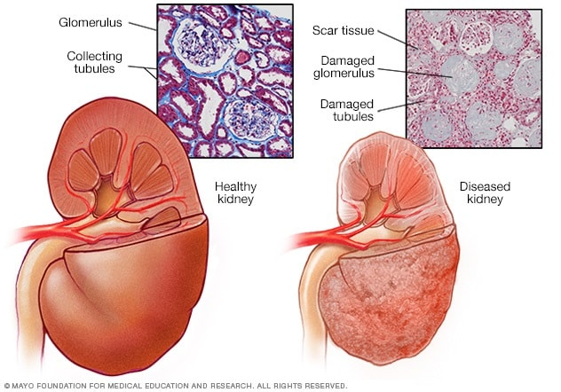
Problem Statement & Motivation
10% of the world is affected by CKD (WHO , 15)
Diagnosis often delayed due to time-consuming manual analysis
Black-box AI/ML models lack interpretability → low trust among clinicians

Slide 3
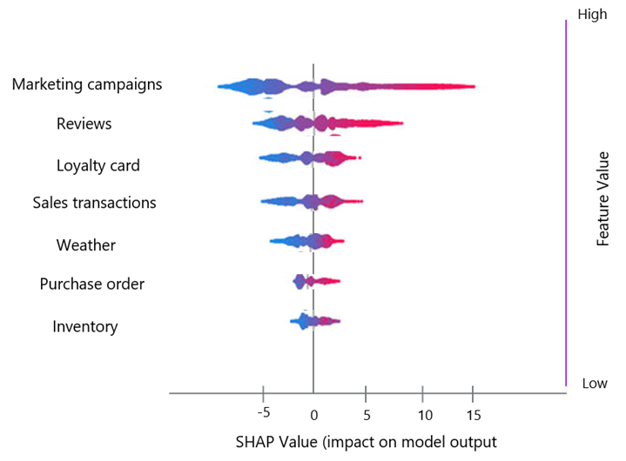
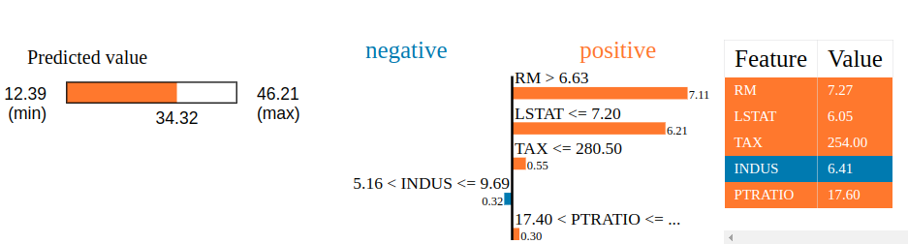
Objectives & Scope
Build an accurate + explainable predictive model
Translate outputs into natural language using LLMs/fine-tuned models
Reduce diagnosis time & assist doctors in efficient diagnosis with actionable insights.
source: Explanatory argumentation in natural language for correct and incorrect medical diagnoses

Slide 4
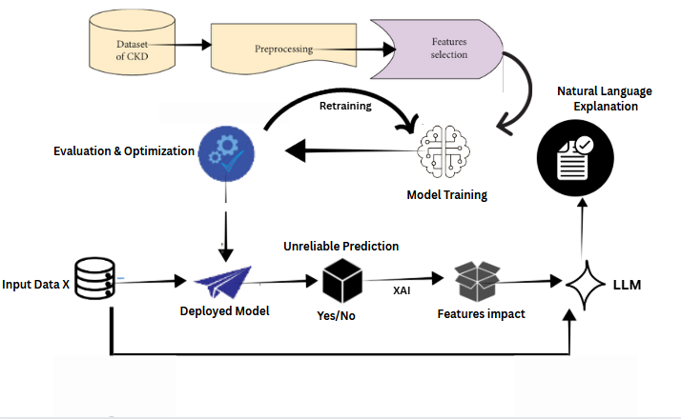
Proposed Methodology
Key stages:
Clinical data preprocessing
Model training & optimization
XAI methods for feature impact
LLM/fine-tuned model for explanation

Slide 5

Deliverables & Outcomes
Deliverables:
Trained CKD prediction model
Explainability layer with SHAP/LIME etc.
Natural language explanation engine
CKD Dashboard
Expected Outcomes:
Improved diagnostic explainability
Reduced diagnosis time
Increased trust and adoption of AI in healthcare

